Slide 1
Balance & Vitality
11th October 2024
Maastricht University
Nienke Plompen

Slide 2
Programme of the day
Welcome & Introduction Balance & Vitality
1. Energy management
2. Purpose & core values
3. (Limiting) beliefs
4. Positive rituals & personal action steps
Notes:
Wanneer voelde je je echt in je element?
Diverse group: nice! We’re allhumans, all want certain kind of balance, vitality: grow from certain situations. Experience stress.

Slide 3
Objectives
Managing energy, not time is the key to high performance and personal renewal
Insight in personal energy management
Personal action plan to achieve prefered work-life balance

Slide 4
Share
How do you score your current work-life balance on a scale of 1-10?
How do you recognize when your work-life balance is disturbed? What signals do you recognize?
What impact would a good work-life balance have for you?

Slide 5
1. Energy management
Energy
Physical
Emotional
Spiritual
Mental
4 types of energy:
Physical
Emotional
Mental
Spiritual

Slide 6
Energy score: check your battery
Which energy source needs attention? Where can I gain energy:
Sleep
Nutrition
Exercise & movement
Breaks
Do more fun things
More attention for friends and family
Positive mindset
More focus, less distraction
Checking-in, checking out
Reflection
Purpose & core values
Meaning
….

Slide 7
2. Purpose & core values
Are you ‘on track’?

Slide 8
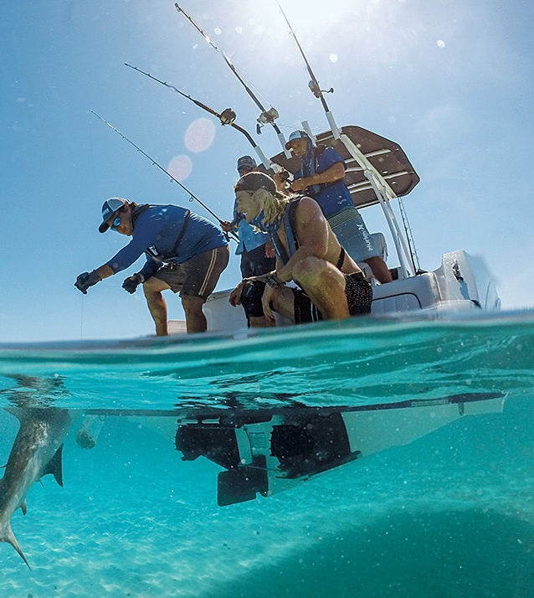
Living your core values
Check: are they truly your positive values?
What are your top 3 values?
When do you experience these values in your work?
Are they more towards achieving something or avoiding something?
Notes:
Kort: check Ask: why is that important.
Example of Nienke: connection is important to me. Also because I do not want to be left out of the group.
Connection to myself / connection to others / connection to the universe / society
Creativity / simpleness / depth (space)

Slide 9
Towards or away from?
What are your top 3 values?
When do you experience these values in your work?
Are they more towards achieving something or avoiding something?
Check: are they truly your positive values?
Notes:
Ask: why is that important.
Example of Nienke: connection is important to me. Also because I do not want to be left out of the group.
Connection to myself / connection to others / connection to the universe / society
Creativity / simpleness / depth (space)

Slide 10
Core value exercise
Relax
Feel, not think
Dream / in an ideal world
Re-member

Slide 11
Core values drawing
What does it look like, if you experience your core values fully, if you are ‘at your best’
in your work?
in your privat life?

Slide 12
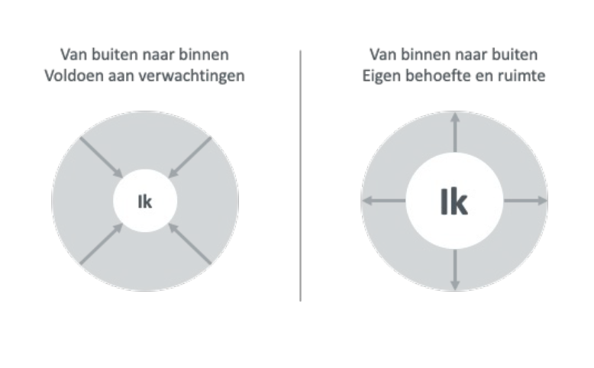

Slide 13
Healthy Mind Platter David Rock & Dan Siegel, Neuroleadership Institute
Healthy Mind Platter model
Analogue to ‘Schijf van 5’: menu for a healthy mind Praktical translation of neuro-science to daily life Mental well-being and a creative and productive brain asks a daily intake of 7 activities
Each activity has a unique contribution No ‘one size fits all’ recipe Combining highly recommended!

Slide 15
Sleep time
Slapen geen passieve toestand
Herstelt lichaam en geest
Consolideert ons geheugen en leervermogen
Gemiddeld 8 uur slaap
Kort dutje van 10 min heeft goed effect op o.a. alertheid en functioneren

Slide 16
Physical time Focus time
Zuurstof Versterkt verbindingen & groei Regelmaat van belang Inzet sport en bewegen bij depressie en burn-out
Tegenhanger van multi-tasken Tegengaan versnippering en prikkels
Bewuste expliciete aandacht voor één taak

Slide 17
Connecting Play time time
Sociaal contact als basisbehoefte Verbinden met mensen & natuur Uitwisselen van emoties en gedachten Positieve sociale steun – gezien worden Vertrouwd worden & je vertrouwd weten
Het plezier van spelen
Houdt het brein ‘jong’
Verband:
‘ spelen - intelligentie - associatief denken’
Natuurlijke, leuke manier om te experimenteren

Slide 18
Down time Time in
Iets doen zonder vastgesteld doel Opladen In het moment zijn Door integratie nieuwe inzichten
Vertragen, mediteren, bewust reflecteren Naar binnen gekeerd
Integratie van ervaringen, gevoelens, gedachten.. Kalme staat - sympathisch zenuwstelsel tot rust

Slide 20
Assignment: take a walk
Which of these 7 activities do you do allready? Which of these you do not do and would like to experiment with? Which can you do more of / or deserve more attention in your life? How can you develop new patterns / habits, so that all 7 will have a natural space in your day? Who or what do you need for that?
What tip(s) do you have for others?

Slide 21
3. Know your beliefs
What holds you back?
I have to…
Be excellent at my job.
Be flexible and super involved at work.
Be supportive to…….
Follow all communication every day and stay up to date.
Stay fit always.
Stop complaining, because...
Stop being insecure/afraid.

Slide 22
How beliefs work
Event
Consequence
Behavior
Feelings
Thoughts
Notes:
Voorbeeld: je wordt niet uitgenodigd na een intake gesprek met de klant.

Slide 23
Assignment
Individual Reflect on experiences and write down 3 limiting beliefs that hold you back in gaining more vitality and a healthy work-life balance
(e.g. I have to do everything perfect, I am not creative, I am not good enough…)
Think about situations when you experienced a disturbed work-life balance, where you felt ‘stuck’. Which thoughts did you have?
Share:
A tells about a specific case where they felt ‘stuck’
B listens and looks for limiting belief(s) that A expresses. (Remember: We do not have to solve it!)
A chooses the most important belief (that holds them back to most).

Slide 24
Reframe beliefs
What positive aspect do you want to keep from this belief? (Even though you do not want it any more, it made you who you are today)
Challenge the limiting belief
Is it true?
Is it really true?
Is the opposite also true? (realistic examples)
Who would you be without this belief?
Based on The work – Byron Katie
What ‘new’ belief would suit you better? (E.g. I can change and learn. Remind yourself of it)

Slide 25
Questions
…
Hero
Grave stone

Slide 26
Recap
Energy management
Core values: ‘me at my best’
Challenge limiting beliefs

Slide 27
4. Positive rituals & personal action steps
What is your biggest insight or take-away?
Which ritual can you install?
What is the first (small) step?
How will you monitor progress?
Who or what can support this new ritual?
Action
To achieve ….., I am going to …. (more / less)… starting ….
Notes:
To have more control on my schedule,
4. Actie: Om ...........te bereiken, ga ik meer/minder .......... startend .....
Voorbeelden:
• Om met meer aandacht bij mijn huisgenoten te zijn, ga ik elke dag als ik mijn werk afgerond
heb 2 minuten een ademhalingsoefenings doen voordat ik naar mijn huisgenoten ga
• Om meer grip te krijgen op mijn week, ga ik elke zondagochtend samen met mijn partner een
week evaluatie en vooruitblik doen

Slide 28
Evaluation
https://maastrichtuniversity.eu.qualtrics.com/jfe/form/SV_5ikB9VbLl08gm9w Balance & Vitality 11 October 2024

Slide 29
Spreek je uit!
Sincere interest - Warmly confrontational - Future oriented
We offer coaching, advice, workshops and training trajectories, both in-company and via open enrolment.
Would you like to discuss the options for either your personal development or your organisation’s development? Our first meeting is non-committal, so feel free to contact us.
@ - contact@leadingacademic.nl www - leadingacademic.nl

